Slide 1

Mission Debriefing Dashboard
A Web-Based Full-Stack Dashboard for Mission Information Management
Postgres DB
Node.js Backend
REST API
JS Frontend

Slide 2
Project Overview
A full-stack application demonstrating client–server architecture, API design, database integration, and dynamic frontend rendering — built to centralize and streamline mission debriefing workflows.
It transforms structured mission data into an accessible and interactive dashboard for post-mission review and debriefing. It brings mission information from different sources together in one centralized interface, making it easier to access, navigate, and review.
Centralized Dashboard
Data Visualization
Web-based interface for organizing mission debriefing information into structured, navigable sections.
Map-based and structured visualizations for mission information review
Editing Capabilities
CSV Export
In-dashboard editing of selected mission fields with backend persistence via REST API.
Export mission records into a structured CSV file for external use and record keeping.

Slide 3




System Architecture
Primary Data Flow
Map Integration Pipeline
01
PostgreSQL
GeoServer
Persistent mission data storage
Serves geospatial layers and tile data via OGC-compliant endpoints.
Node.js + Express.js
02
Server-side logic and API routing
OpenLayers
REST API / JSON
Client-side mapping library that consumes GeoServer layers and renders them in the browser.
Structured HTTP communication layer
03
Frontend JavaScript
Dashboard Map View
Dynamic rendering and DOM updates
Interactive map panel embedded within the mission debriefing interface.

Slide 4
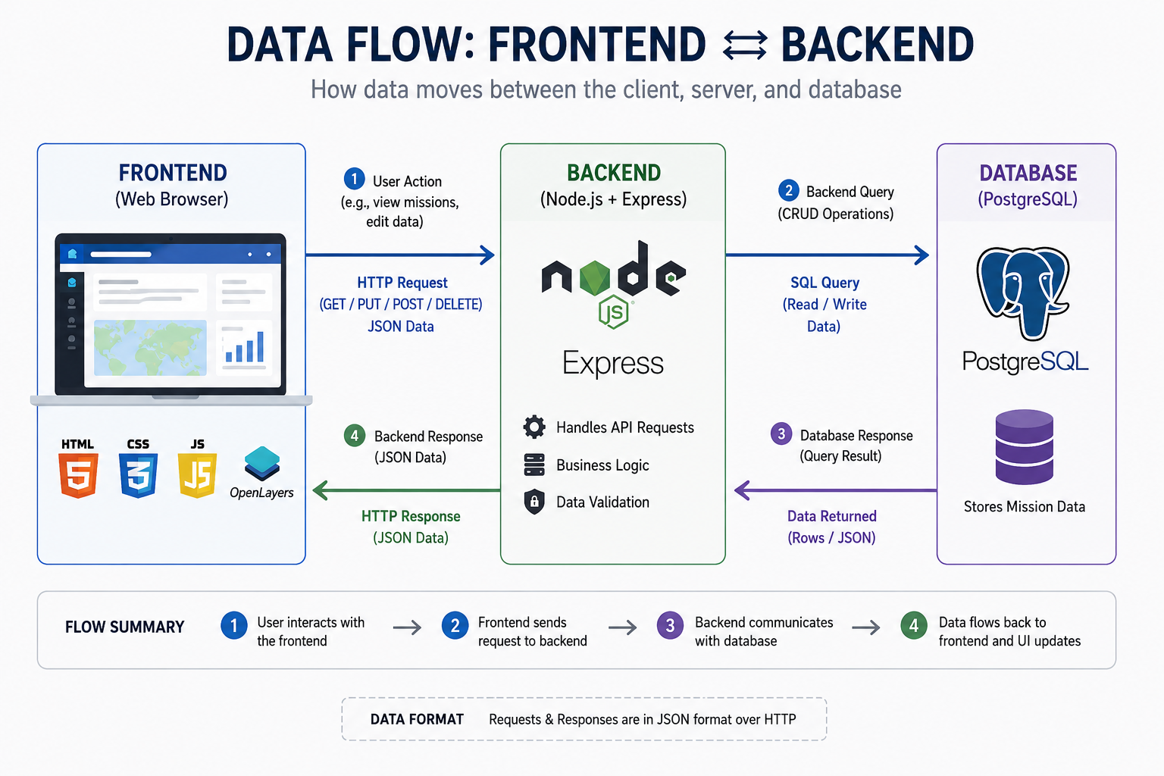

Slide 5
Tools & Technologies
Frontend – HTML, CSS, JAVASCRIPT
Provides the user interface for viewing, navigating, and interacting with mission information
Backend – Node.js, Express.js
Handles API requests, application logic, and communication with the PostgreSQL database.
Database – PostgreSQL
Stores and manages structured mission information using PostgreSQL
Mapping – OpenLayers
Displays interactive geographic information using OpenLayers and map layers provided through GeoServer
Communication – Rest API – HTTP – JSON
Enables data exchange between the frontend and backend through REST APIs and JSON.
Export - CSV
Allows mission information to be exported as a structured CSV file for external use and record keeping.

Slide 6
Backend: Node.js – Express.js
The backend layer is responsible for all server-side execution, business logic, and database communication. Node.js and Express.js together form a lightweight yet capable API server.
Node.js – Server Runtime
JavaScript runtime for server-side execution outside the browser
Executes application logic and enforces business rules
Manages all database communication with PostgreSQL
Express.js — Web Framework
Lightweight web framework built on top of Node.js
Creates and manages all REST API routes
Handles incoming HTTP requests and outgoing responses
Together, Node.js and Express.js form the core backend layer of the dashboard, enabling communication between the frontend and PostgreSQL database. They handle API requests, process application logic, retrieve or update mission data, and return the required responses to the frontend for dynamic display.

Slide 7
Core Concepts
Five foundational software engineering principles underpin the architecture and implementation of the Mission Debriefing Dashboard.
Client–Server Architecture
API Communication
JSON Data Format
Separation of frontend, backend, and database responsibilities ensures scalability, maintainability, and clear boundaries of concern across the application.
The frontend communicates exclusively with the backend through structured HTTP requests, receiving well-defined responses that decouple the two layers.
A structured, lightweight format for transferring mission data between frontend and backend, enabling consistent parsing and rendering across all dashboard components.
Dynamic UI Updates
Database Operations
JavaScript processes API responses and updates dashboard elements in real-time without full page reloads, providing a responsive user experience.
PostgreSQL stores all mission data; backend APIs handle retrieval, filtering, and update operations through parameterized queries and connection pooling.

Slide 8

Final Dashboard
The completed Mission Debriefing Dashboard integrates all five functional layers into a unified, user-facing interface. The placeholder below represents the final application screenshot.
Delivered Features
Screenshot Placeholder: Replace this section with the actual Mission Debriefing Dashboard screenshot before presenting.
Mission Information Display — Structured presentation of all mission fields
The dashboard consolidates mission debriefing data into a single, navigable web interface — eliminating the need for fragmented manual records and enabling structured review, editing, and export workflows.
Interactive Editing — In-place field editing with backend persistence
Map Visualization — OpenLayers map panel with GeoServer layers
Dynamic Data Rendering — Real-time DOM updates from API responses
CSV Export — One-click export of mission data records

Slide 9
Key Achievements
The project successfully delivered a complete, functional full-stack application across all planned components.
Database Integration
RESTful API
PostgreSQL integrated with Node.js/Express.js backend using connection pooling and parameterized queries.
Full REST API implemented for data retrieval, filtering, and field-level update operations.
Dynamic Frontend
Map Visualization
JavaScript-driven rendering with real-time DOM updates from API responses — no page reloads.
OpenLayers and GeoServer integrated for interactive geospatial mission data display.
Interactive Editing
CSV Export
Frontend editing controls connected to backend update endpoints with form validation.
Structured CSV export implemented for mission data portability and downstream reporting.

Slide 10
Challenges & Solutions
Five significant engineering challenges were encountered and resolved during development, each yielding transferable technical insights.
1
2
3
Client–Server Communication
Database Integration
Dynamic Data Rendering
Challenge: Understanding asynchronous HTTP requests and API response handling across the stack.
Solution: Implemented proper async/await request–response patterns with structured error handling at each layer.
Challenge: Connecting the backend with PostgreSQL and retrieving correct, filtered records reliably.
Solution: Designed efficient parameterized queries and implemented connection pooling for stability.
Challenge: Processing JSON API responses and displaying values correctly across all dashboard components.
Solution: Implemented robust data parsing routines and systematic DOM manipulation patterns.
4
5
Map Integration
Data Editing
Challenge: Configuring GeoServer layers and rendering them correctly through OpenLayers in the browser.
Solution: Applied proper layer configuration and coordinate reference system (CRS) handling.
Challenge: Connecting frontend editing controls with backend update operations and ensuring data integrity.
Solution: Implemented client-side form validation and dedicated API update endpoints per field type.

Slide 11
Future Enhancements
The current implementation provides a solid foundation. The following enhancements are identified as high-value extensions for subsequent development phases.
Analytics & Reporting
Infrastructure & Integration
Advanced mission analytics and reporting dashboards
Real-time or near-real-time data integration pipelines
Additional chart types and data visualization components
Enhanced data validation and comprehensive error handling
Historical mission comparison and trend analysis
Role-based access control and user permissions
Automated debriefing report generation
Integration with additional mission data sources

Slide 12
Conclusion
Centralized Mission Management Developed a unified dashboard that brings mission information together in a structured and easily accessible interface.
Full-Stack Implementation Successfully connected the frontend with a Node.js and Express.js backend and PostgreSQL database to create a complete client-server application.
Dynamic Data Handling Implemented REST APIs and JSON-based communication to retrieve, process, display, and update mission information dynamically.
Interactive Visualization & Features Integrated OpenLayers and GeoServer for map visualization along with interactive editing, navigation, and dynamic UI components.
Data Export & Practical Usability Added CSV export functionality and organized the dashboard into multiple debriefing sections, making mission information easier to review, manage, and retain.

